Slide 1
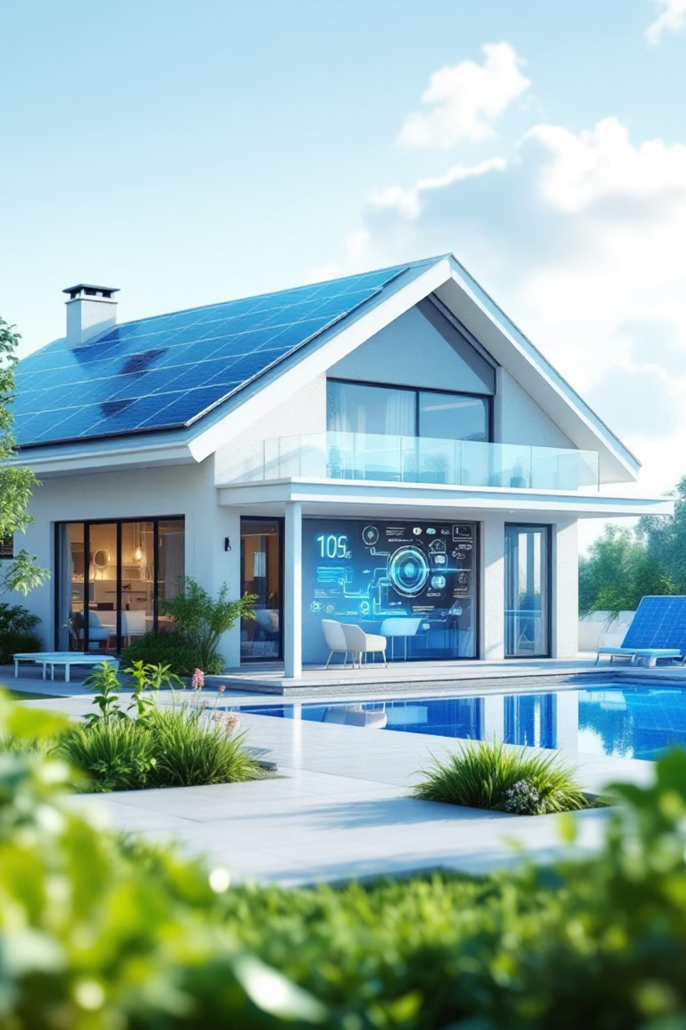

Analysis of Real-World Data from a Solar-Equipped Smart Home
A data-driven exploration of influence factors on solar energy generation and consumption patterns
Stephan Herbert
4.11.2025

Slide 2

Agenda
About me
Project context
Planning & Technology Stack
Data Sources & Energy Flow
Research Hypotheses
Hypotheses check
Summary and recommendations

Slide 3


About Me
Stephan Herbert
37 years old
Frankfurt am Main
Professional Background
Master degree in Mechanical engineering (TU Darmstadt)
7+ years of experience in the automotive industry (Continental in Frankfurt)
Specializing in NVH / Acoustics with growing expertise in data analysis using KNIME and Power BI.
Career Goal
Transitioning into Data Analyst / BI Analyst roles to leverage analytical skills in data-driven decision making.
Looking for jobs in Frankfurt / Rhein-Main area
Link to LinkedIn

Slide 4
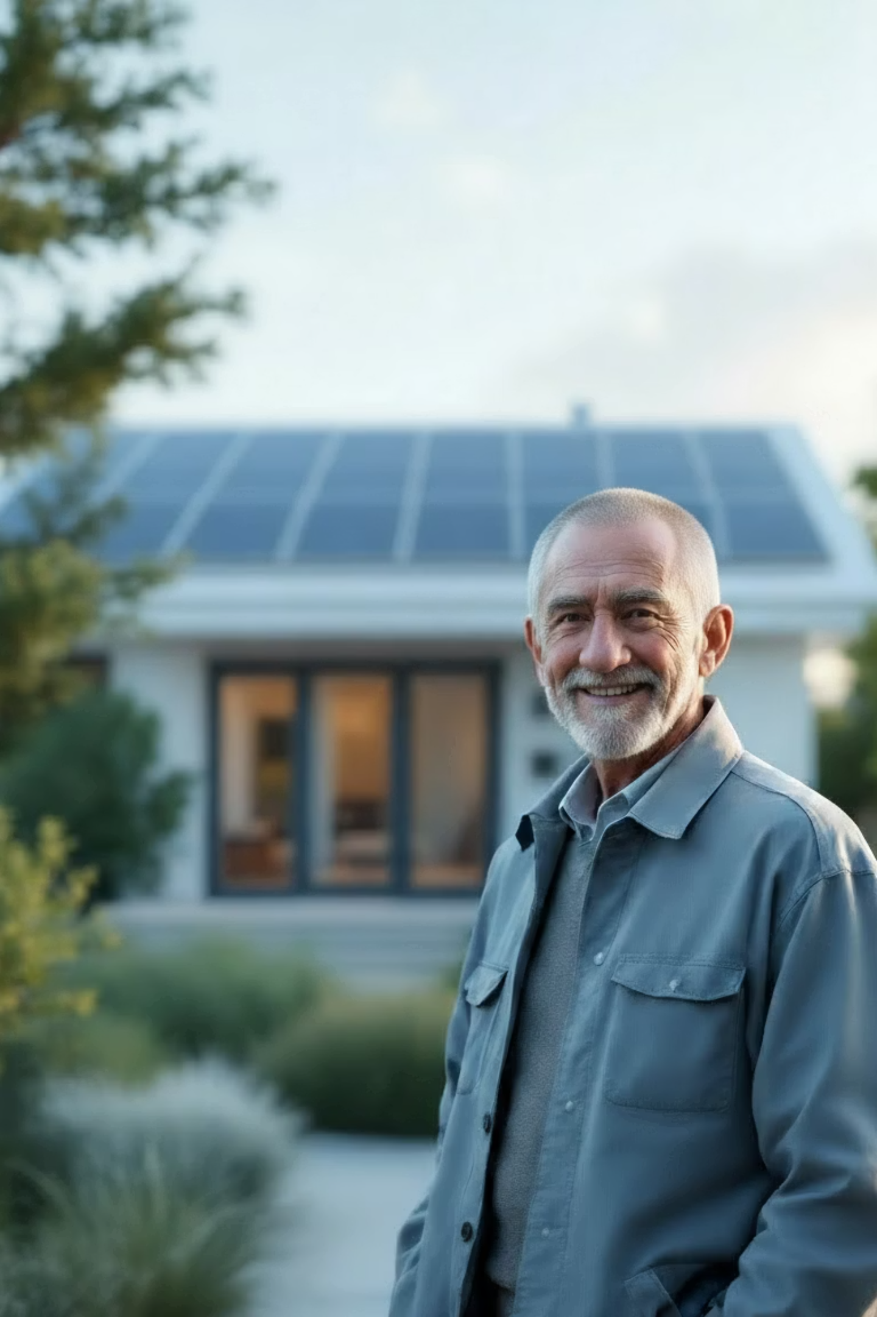
Project Context
Topic
Private smart home data provided by a friend → Real-world data
Data set: electricity / heating + weather data (03/24 – 09/25)
Goal: visualize main insights + give recommendations to stakeholder
PV = Photovoltaic
Stakeholder - Jürgen
Retired engineer and tech enthusiast
Continuously optimizing his smart home system
Motivation
Help Jürgen understand:
Key metrics and influence factors on his (smart) home
Optimize his system for better financial returns

Slide 5
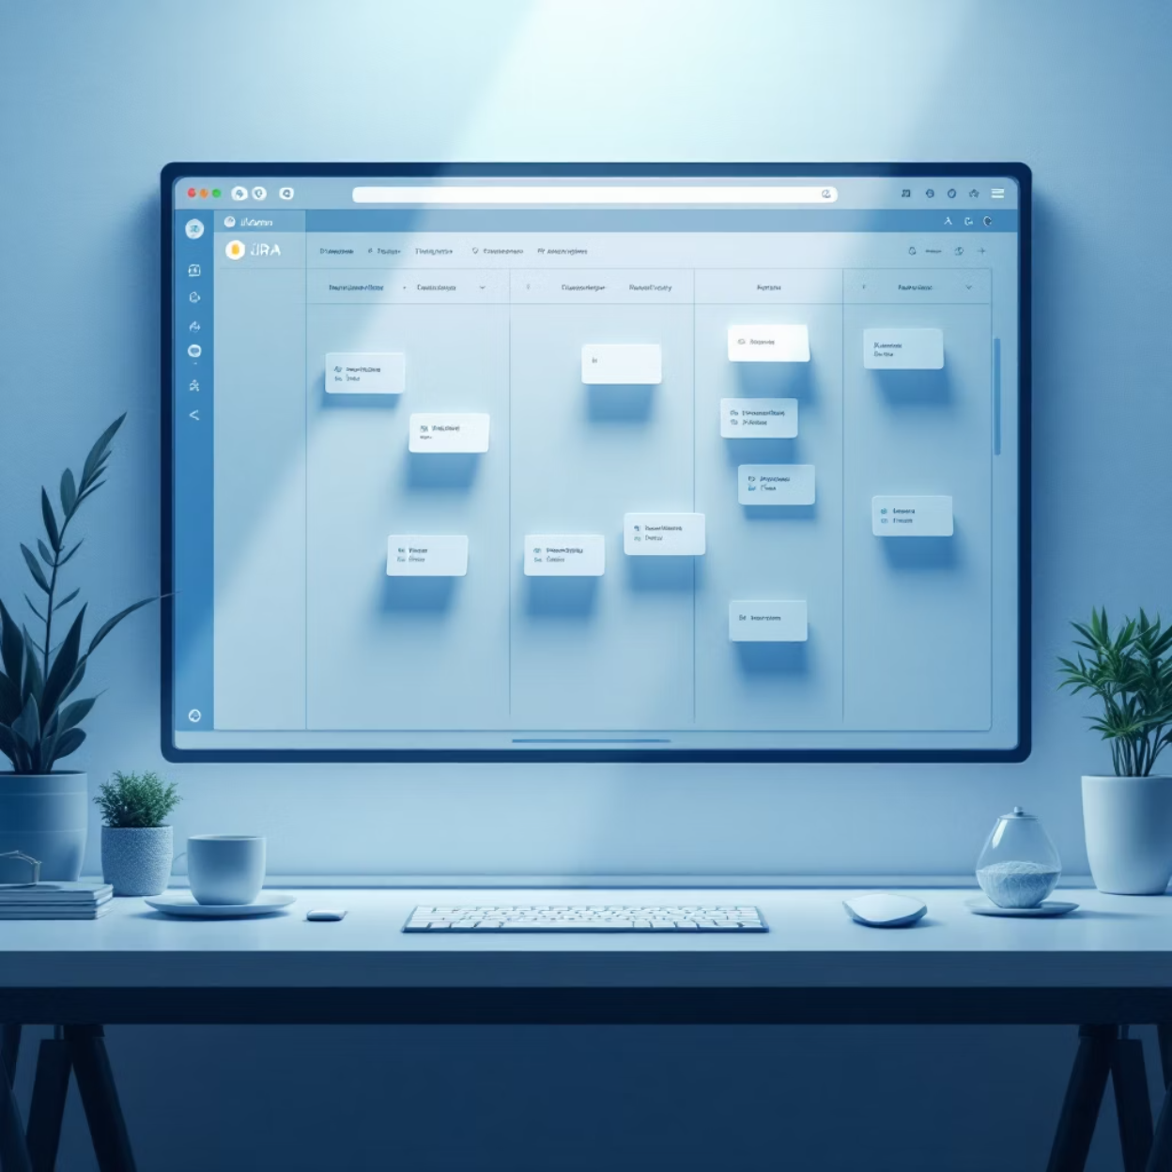


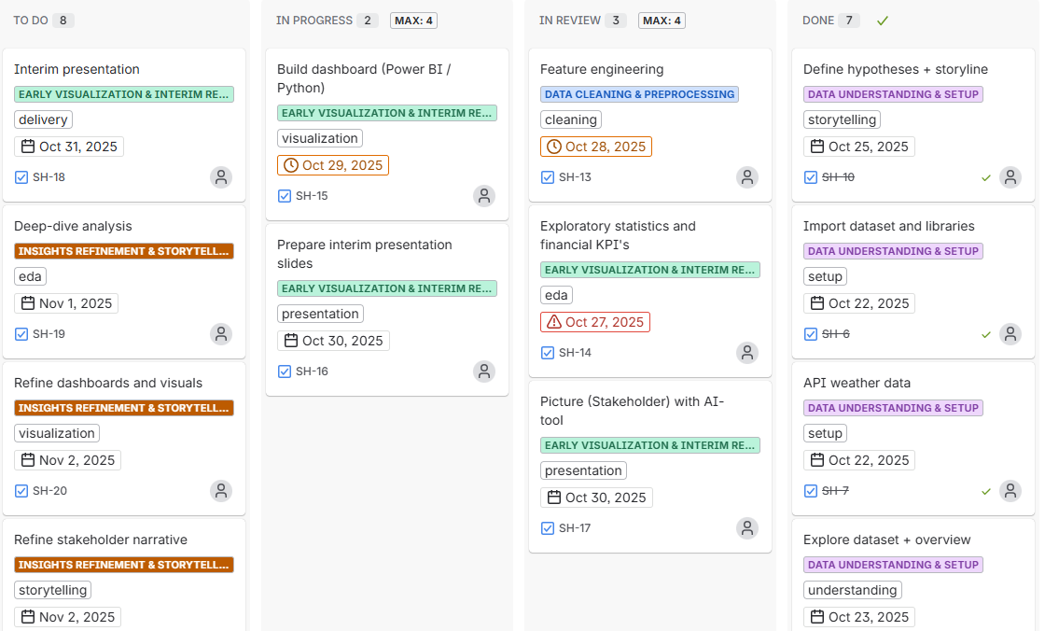
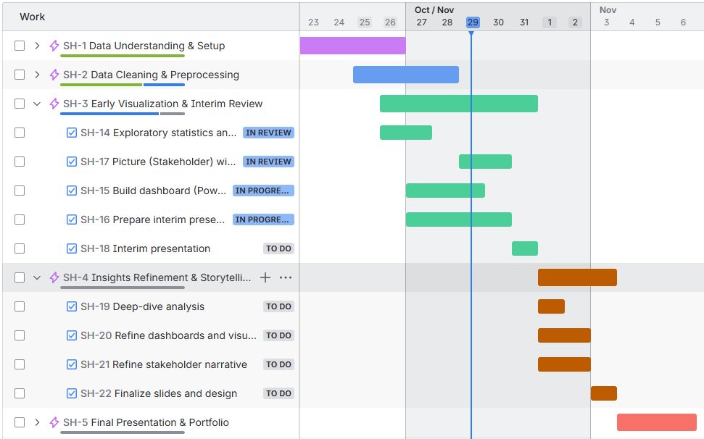




Planning & Technology Stack
Project Planning
Technology Stack
JIRA Kanban board for task tracking and workflow organization.
Python
Jira
Power BI
Streamlit
Gamma AI
PowerPoint

Slide 6



Data Sources & workflow
Data Sources
Energy data from PV system and consumption
9 CSV’s (one per sensor)
1.5 years – every 10 min → Daily aggregations
Power BI
Aggregation
per day
+ additional features
+ correlations
Weather data via OpenMeteo API
Streamlit
API
per day
Financial data from Jürgen's records

Slide 7
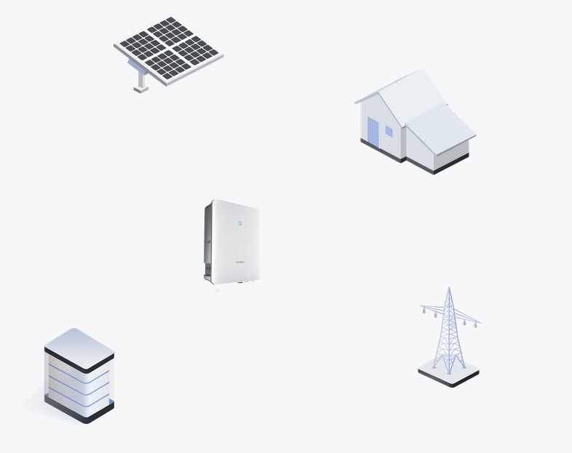
Energy Flow
PV-generation over the day
Energy Flow System
PV = Photovoltaic
PV Modul
PV Energy
House
Consumption
Inverter
Charge
Import
Discharge
Export
Power Grid
Battery
Consumption = PV + Import – Export – (Charge – Discharge)

Slide 8

Research Hypotheses
1. Heating Usage
Heating is used even when outdoor temperature exceeds 15°C
2. Solar energy – Influence factors on PV-generation
Season/month has greater impact on PV generation than weather conditions
3. Energy Independence
Self-sufficiency is only achieved in Q2 and Q3
4. Optimization Potential ⬄ Payback Period
Even under best conditions, the system amortization time can only be reduced by 1 year compared to current conditions

Slide 9




Hypothesis 1: Hot water & Heating usage
1. Hot water
Outliers of hot water usage:
Vacation time?
Sensor issue?
“Only cold showers”?
1.
2.
1
2
Data quality matters – "NaN“-values sometimes zero consumption ⬄ missing data

Slide 10

Hypothesis 1: Hot water & Heating usage
1. Hot water
2. Heating
Outliers of hot water usage:
Vacation time?
Sensor issue?
“Only cold showers”?
Heating used between October – June
Min-°C apparently more important than Mean-°C
Small saving potential for time frames with > 10°C_min
1. Heating Usage
Heating is used even when outdoor temperature exceeds 15°C
Data quality matters – "NaN“-values sometimes zero consumption ⬄ missing data
Heating occasionally used too long (when temperature > X °C), but only ~X% savings potential

Slide 11
Hypothesis 1: Hot water & Heating usage
1. Hot water
2. Heating
Outliers of hot water usage:
Vacation time?
Sensor issue?
“Only cold showers”?
Heating used between October – June
Min-°C apparently more important than Mean-°C
Small saving potential for time frames with T_min > 10°C and T_mean > 15 °C
Data quality matters – "NaN“-values sometimes zero consumption ⬄ missing data
Heating used too long (on 78 “warmer” days), but only ~5 % savings potential (107 m³ out of 2181 m³)

Slide 12
Hypothesis 2: Solar energy – Influence factors on PV-generation
1. Season / sunshine hours
2. Weather conditions
Solar energy highly correlates:
to sunshine hours (0.87)
to daylight hours (0.77)
Huge correlation to weather type (-0.47) cloud coverage per day (-0.62)
Cloudy ⬄ sunny weather:
Q2 / Q3: up to -27 %
Q1 / Q4: up to -83 %
-27 %
2. Solar energy – Influence factors on PV-generation
-83 %
Season/month has greater impact on PV generation than weather conditions
Higher correlation of solar energy to daylight hours (= season) than to weather type / cloud coverage
But: Weather conditions have severe influence too!
PV = Photovoltaic

Slide 13
Hypothesis 2: Solar energy – Influence factors on PV-generation
PV = Photovoltaic
1. Season / sunshine hours
2. Weather conditions
Solar energy highly correlates:
to sunshine hours (0.87)
to daylight hours (0.77)
Huge correlation to weather type (-0.47) cloud coverage per day (-0.62)
Cloudy ⬄ sunny weather:
Q2 / Q3: up to -27 %
Q1 / Q4: up to -83 %
-27 %
-83 %
Higher correlation of solar energy to seasonal effects (daylight…) than to weather type / cloud coverage
But: Weather conditions have severe influence too!

Slide 14

Hypothesis 3: Energy Independence
1. Energy flow + Self-sufficiency %
2. Energy import
Consumed energy is quite stable (~ 9.4 kWh/day)
Import > 50% from October – February
Self-sufficiency >90% from May – August
Days without imports even in November + February
63 % of days with < 1 kWh import
3. Energy Independence
Self-sufficiency is only achieved in Q2 and Q3
April-August: >80% of days have 0-1 kWh grid import (note: “NaN” could be “no import” or sensor issue)
Except Dec & Jan: Every month shows at least 4 days with 0-1 kWh import, even in Q1 and Q4
PV = Photovoltaic

Slide 15
Hypothesis 3: Energy Independence
1. Energy flow + Self-sufficiency %
2. Energy import
Consumed energy is quite stable (~ 9.4 kWh/day)
Import > 50% from October – February
Self-sufficiency >90% from May – August
Days without imports even in November + February
63 % of days with < 1 kWh import
April-August: >80% of days have 0-1 kWh grid import (note: “NaN” could be “no import” or sensor issue)
Except Dec & Jan: Every month shows at least 4 days with 0-1 kWh import, even in Q1 and Q4

Slide 16
Hypothesis 4: Optimization Potential ⬄ Payback period
1. …
2. …
…
…
4. Optimization Potential ⬄ Payback Period
Even under best conditions, the system amortization can only be reduced by 1 year compared to current conditions
…
…
PV = Photovoltaic

Slide 17
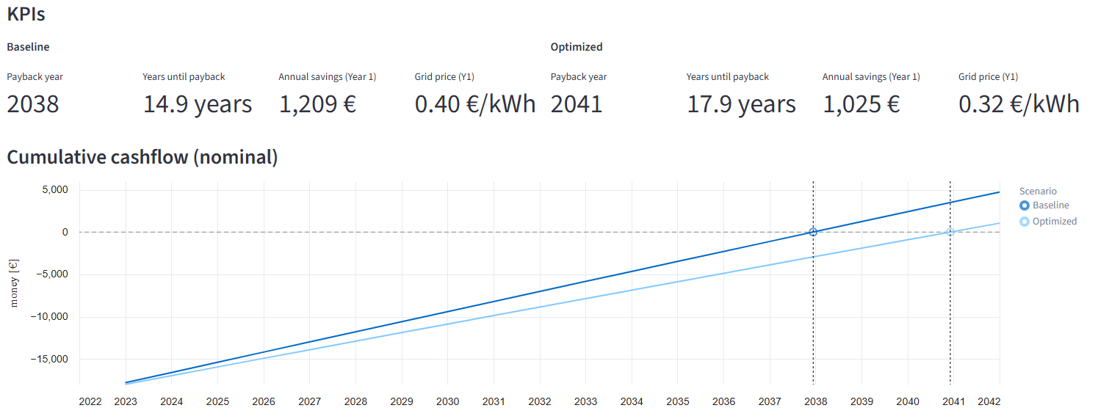
Hypothesis 4: Optimization Potential ⬄ Payback period
1. Hardware
2. Yearly energy costs (Import) ⬄ Feed-in tariff (Export)
a.) Solar panels:
No space left!
b.) Shadow from tree:
Neighbor owns tree
a.) Feed-in tariff : Fixed for 20 years (0.082 € per kWh)
b.) Import costs:
Optimization potential: ~0.32 €/ kWh instead of 0.40 €/ kWh
BUT: fewer yearly costs → longer amortization time
c.) Battery:
Current battery capacity = 9.6 kWh
Consumption per day (avg) = 9.4 kWh ➔ Charged battery lasts for ~ 1 day
d.) Electric Vehicle :
Potential “big battery” in the future
~ 5000 – 6000 € invest!
No hardware optimizations (except electric vehicle)
Cheaper contract results in fewer yearly costs (- 90 €), but higher amortization time (> 3 years)

Slide 18
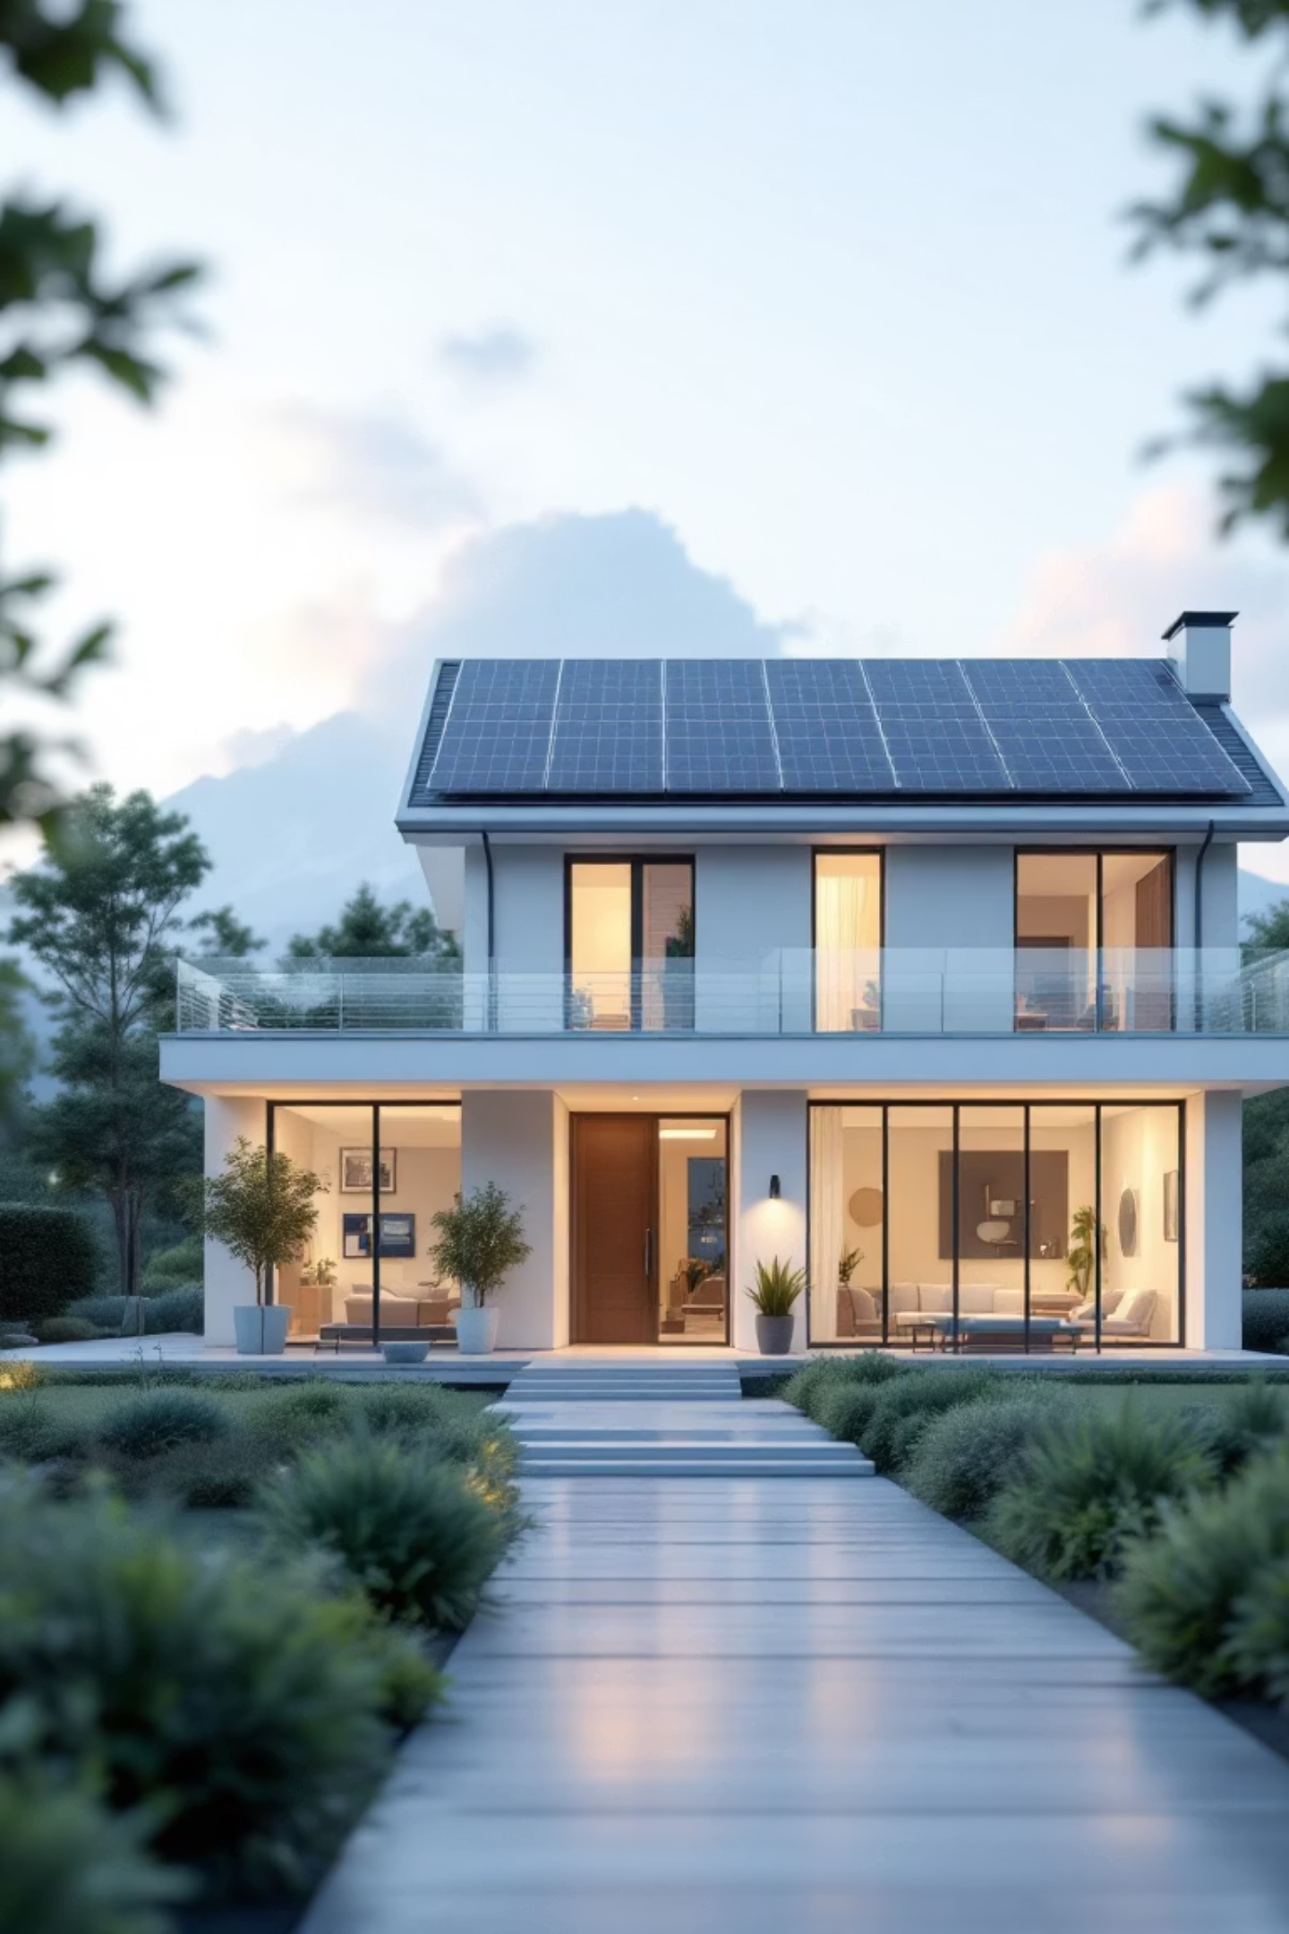


Summary & Recommendations
Heating optimization offers limited savings
Seasonal > weather influences on solar energy
Self-sufficiency achievable in all seasons
Amortization time highly driven by import costs
Main findings
Monitor heating patterns during spring / autumn
Implement data validation checks [NaN values]
Regularly evaluate contracts to reduce yearly costs for import ⬄ feed-in tariffs
Recommendations to Jürgen

Slide 19
Thank you
for your attention!
Interested in discussing data analytics, or career opportunities in BI?
LinkedIn
Connect with me on
Stephan Herbert

Slide 21
Export ⬄

